Slide 1
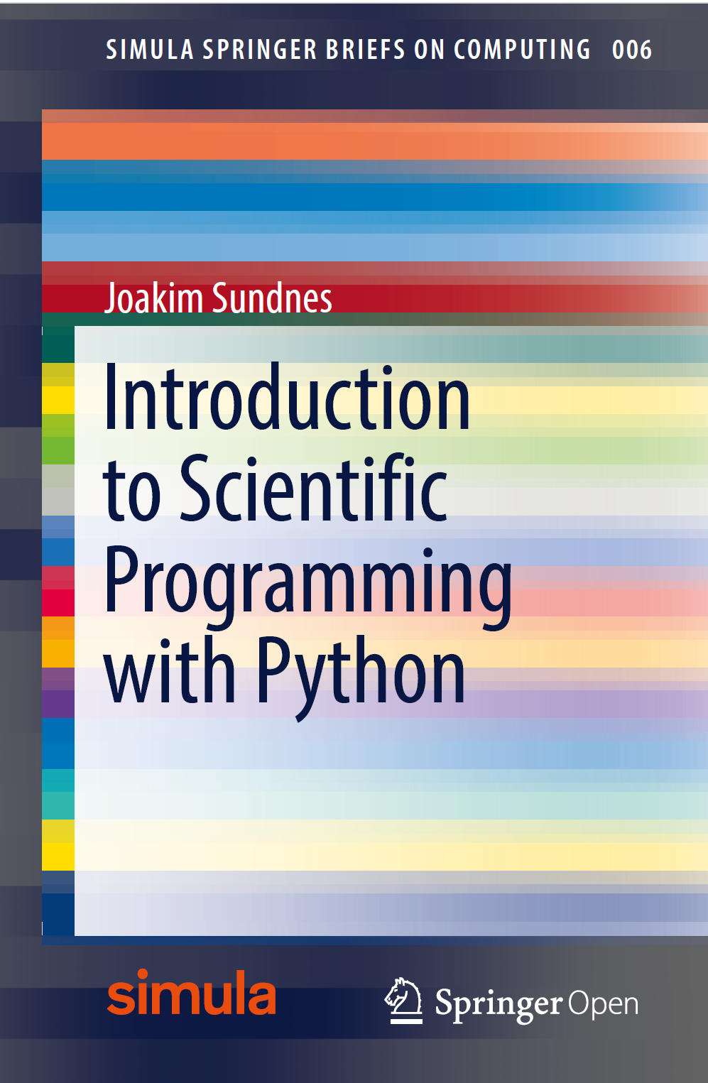
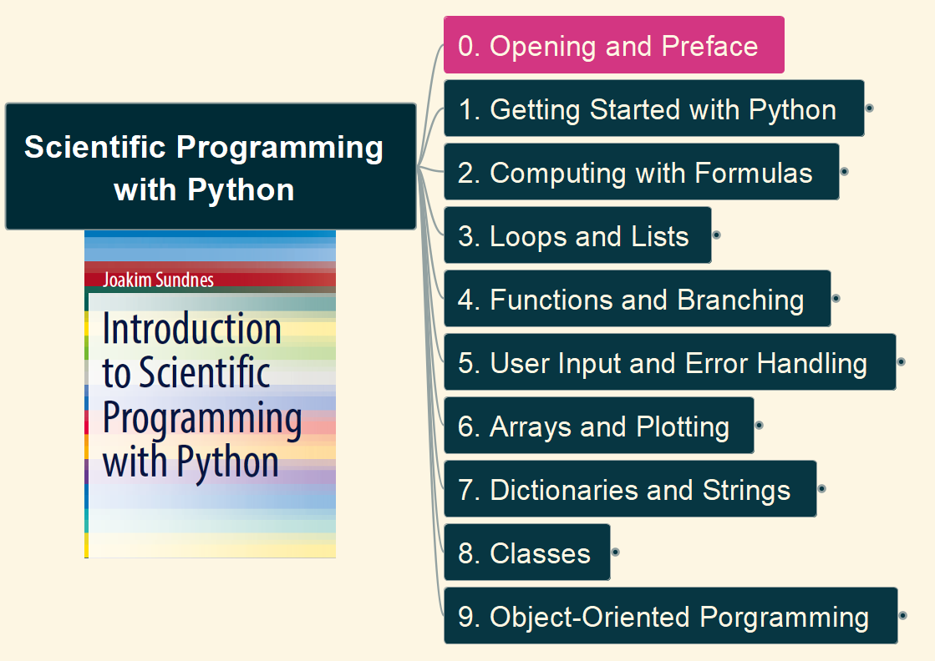
Scientific Programming with Python
001
Opening and Preface

Slide 2
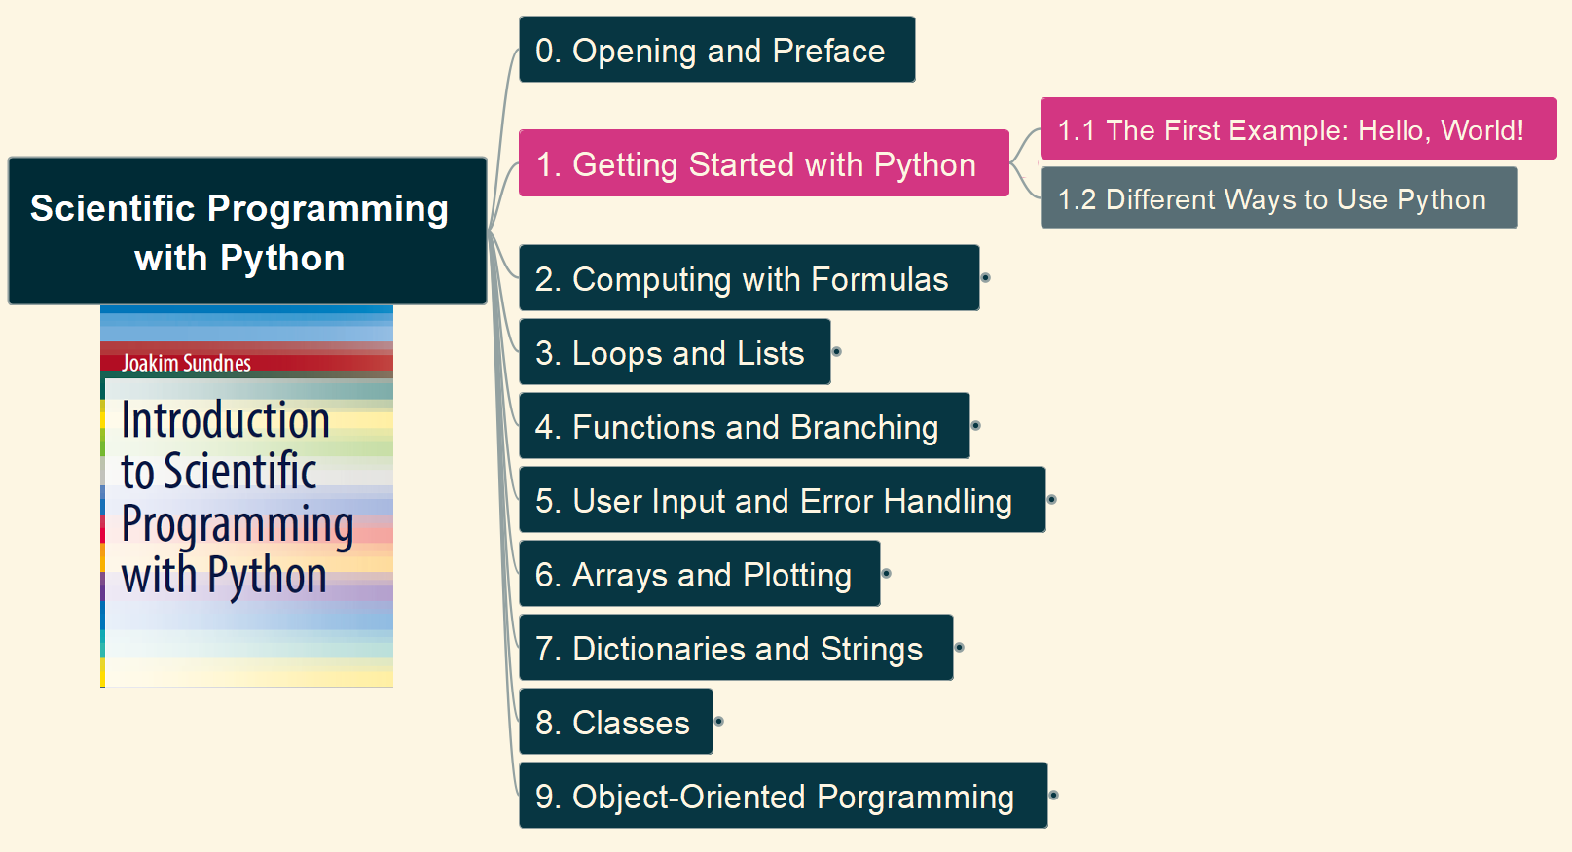

1. Getting Started with Python 1.1 The First Example: Hello, world
002

Slide 3
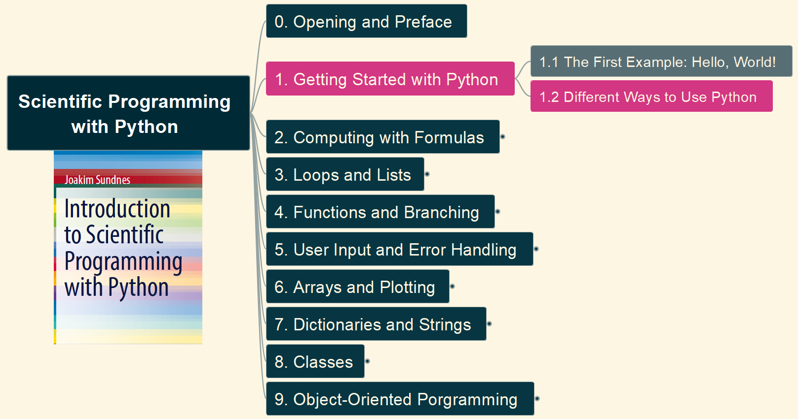
1. Getting Started with Python 1.2 Different Ways of Use Python
003

Slide 4
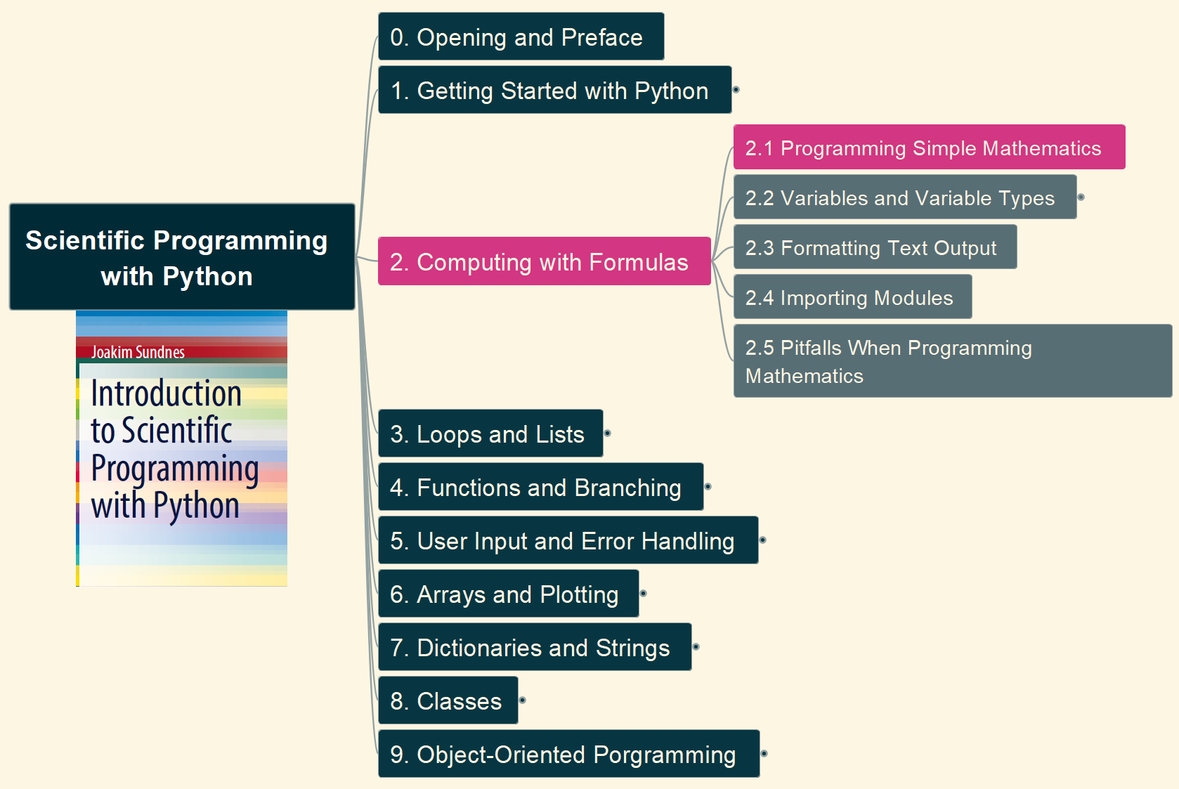
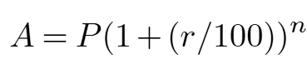
2. Computing with Formulas 2.1 Programming Simple Mathematics
004

Slide 5
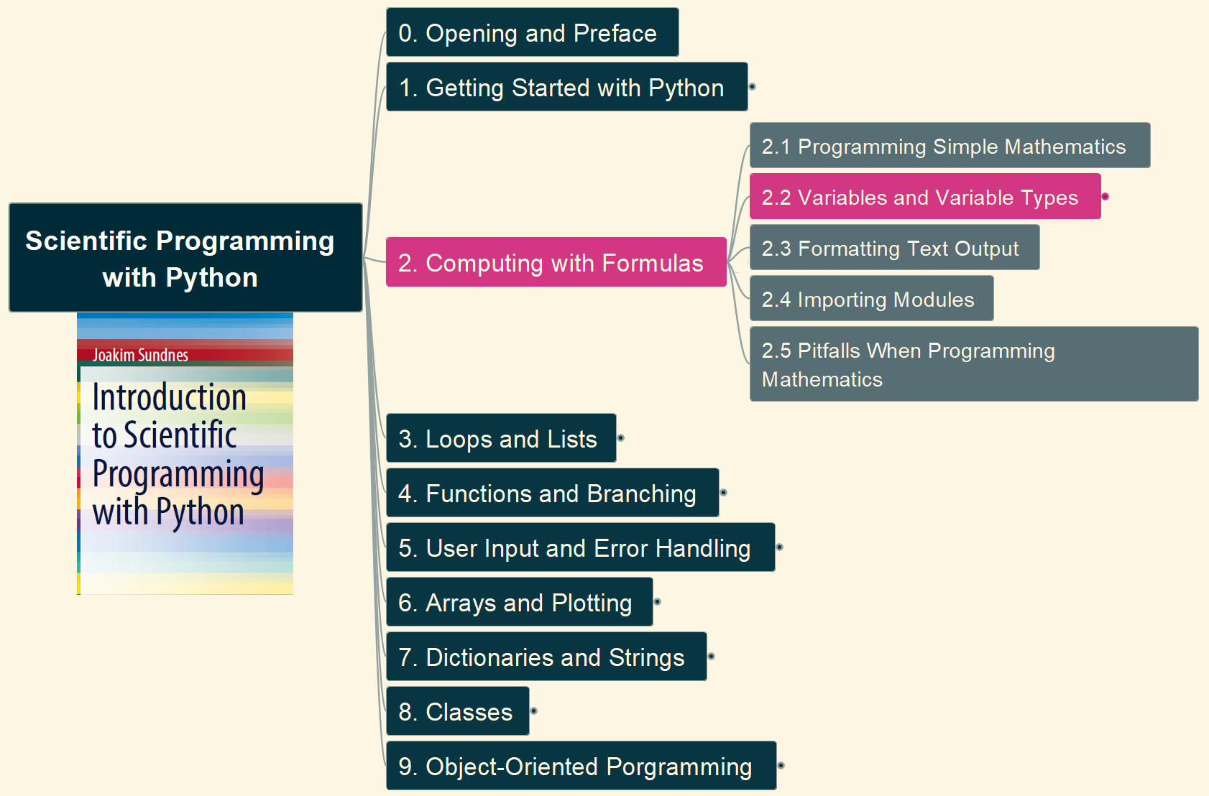
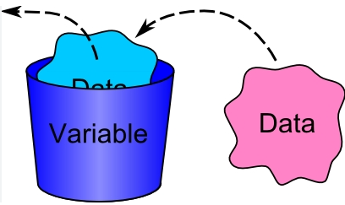
2. Computing with Formulas 2.2 Variables and Variable Types (1)
005

Slide 6
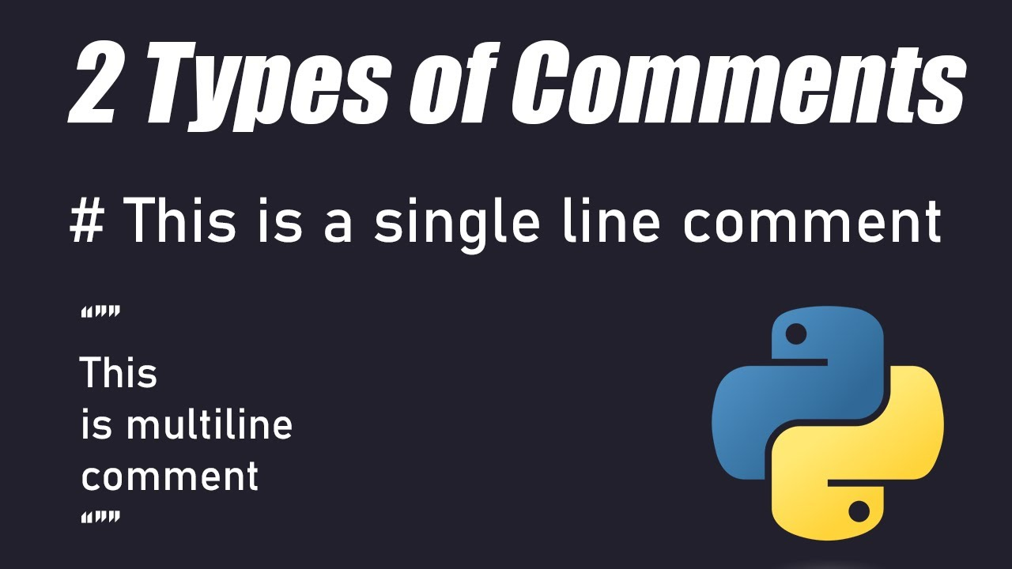
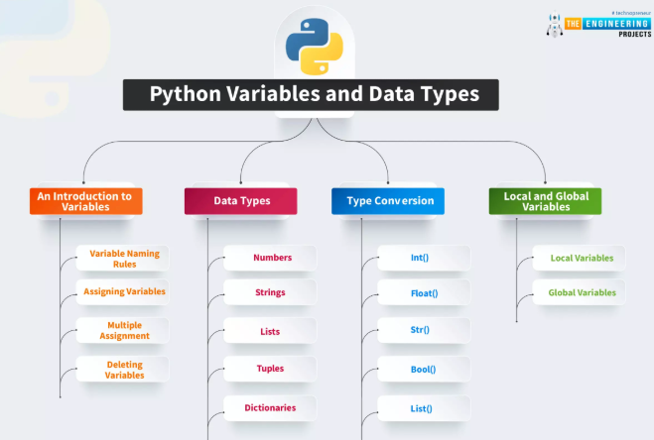
2. Computing with Formulas 2.2 Variables and Variable Types (2)
006

Slide 7
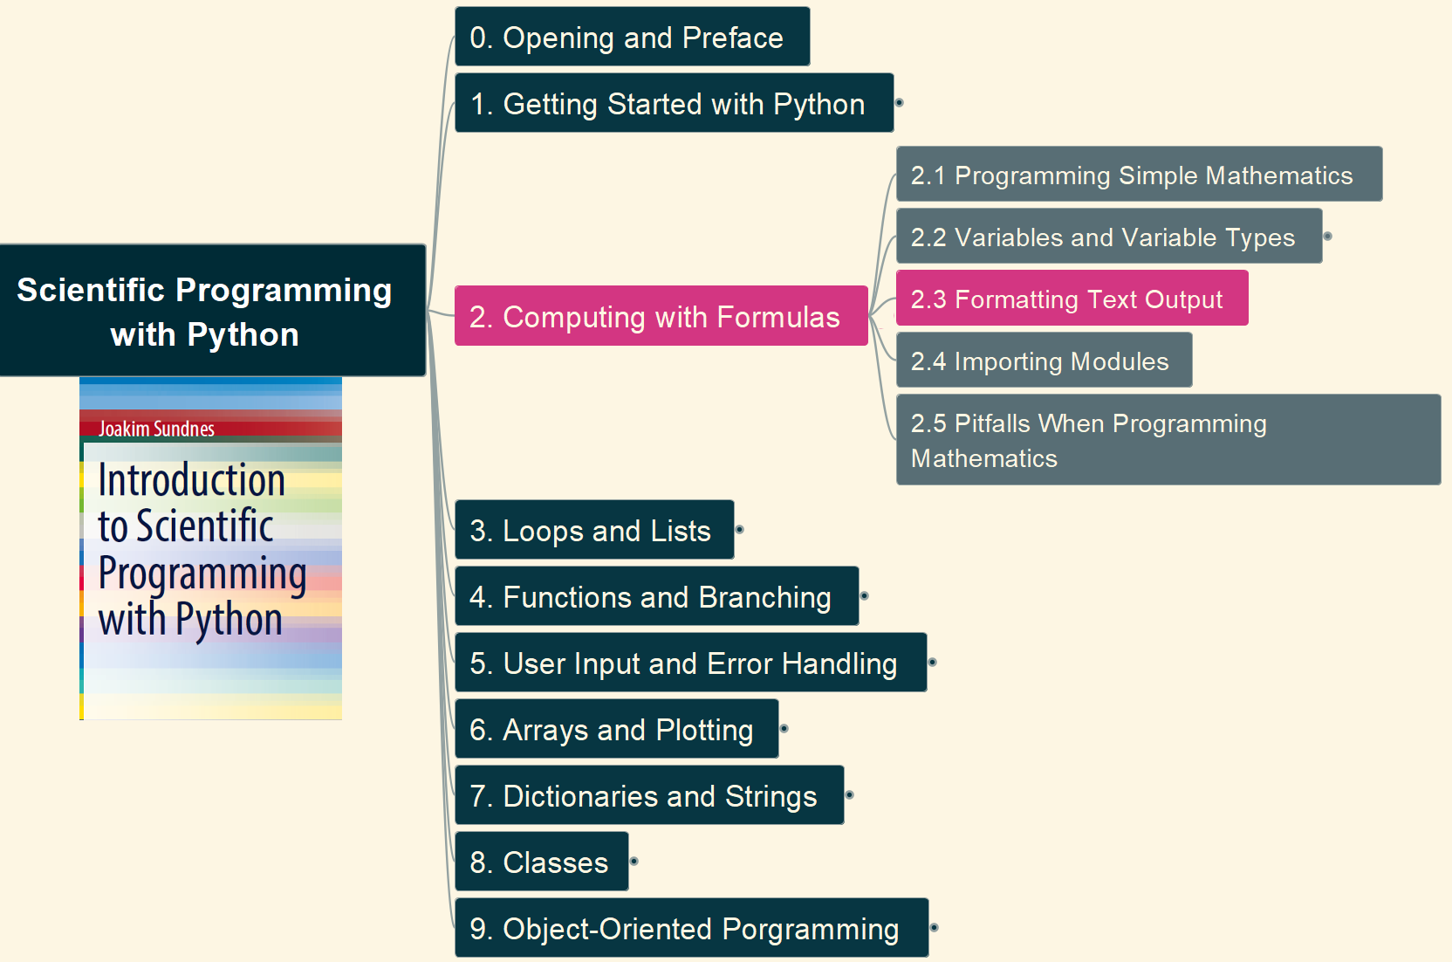
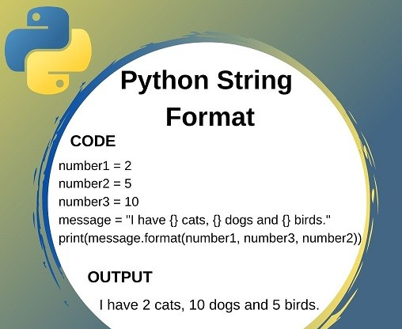
2. Computing with Formulas 2.3 Formatting Text Output
007

Slide 8
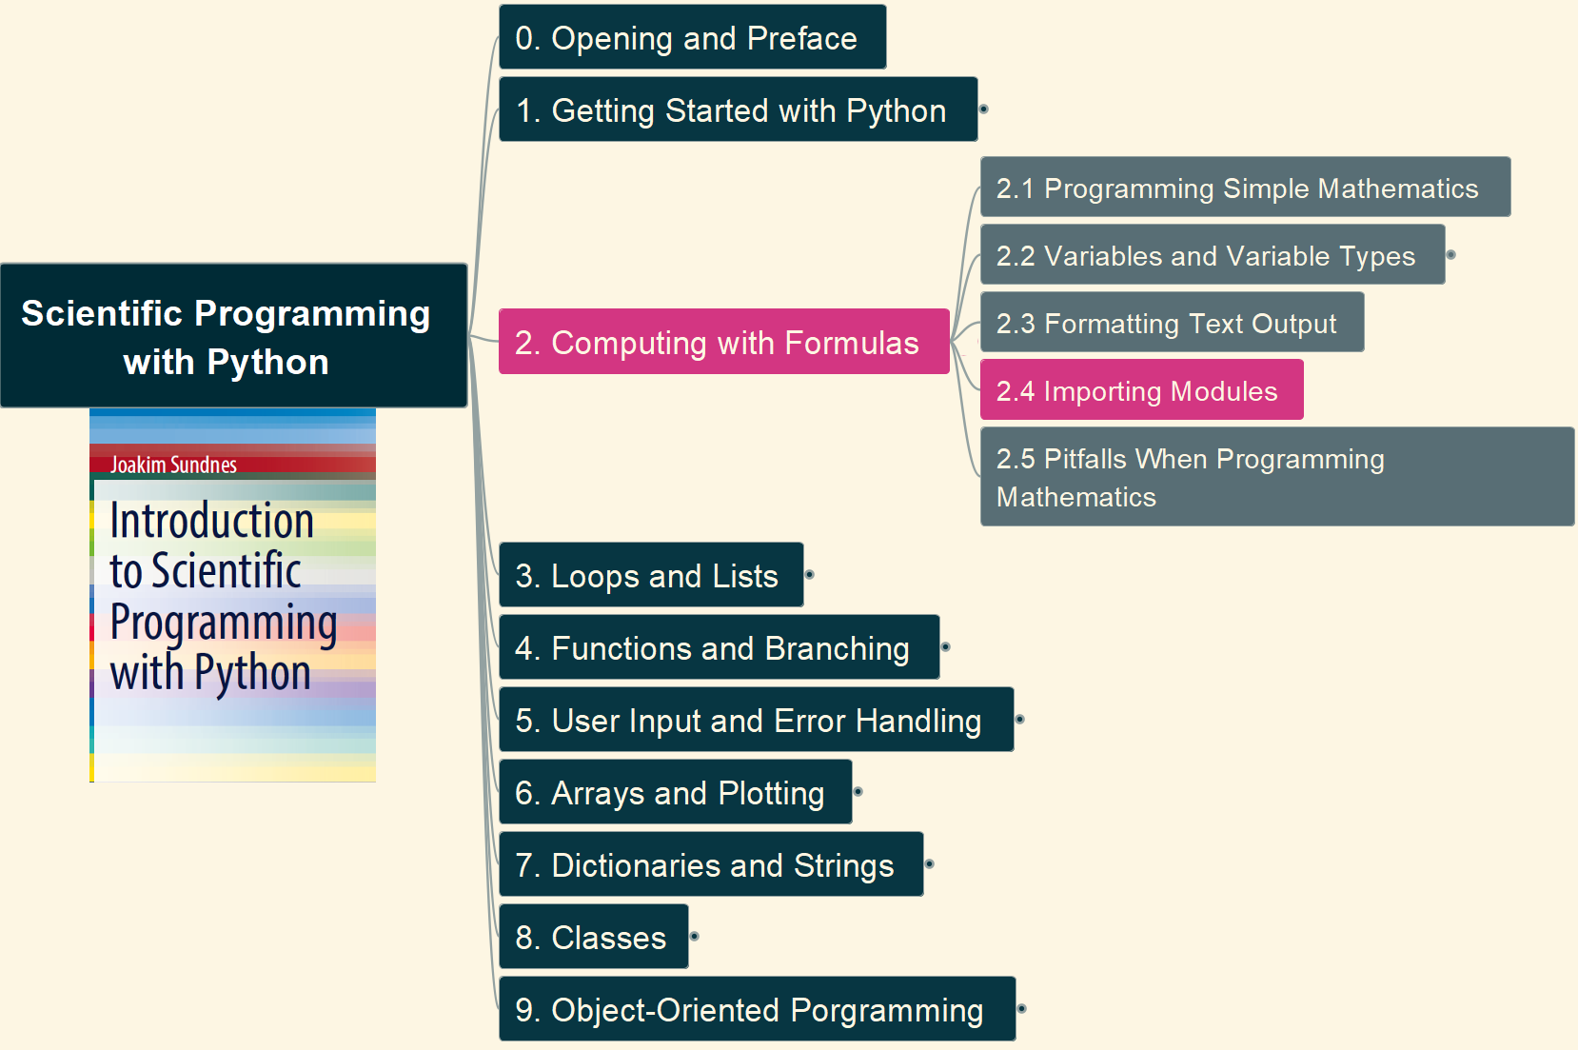
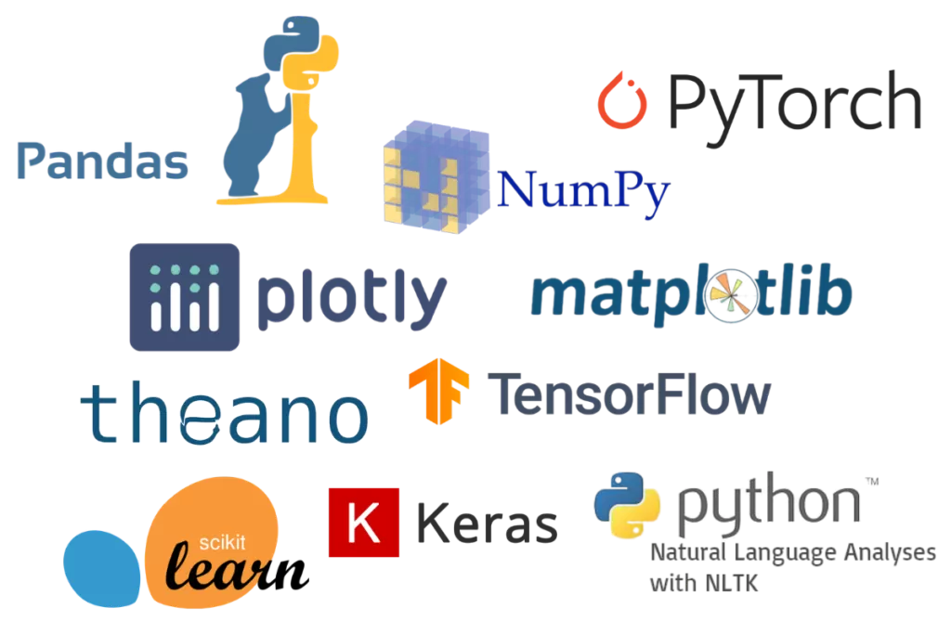
2. Computing with Formulas 2.4 Importing Modules
008

Slide 9
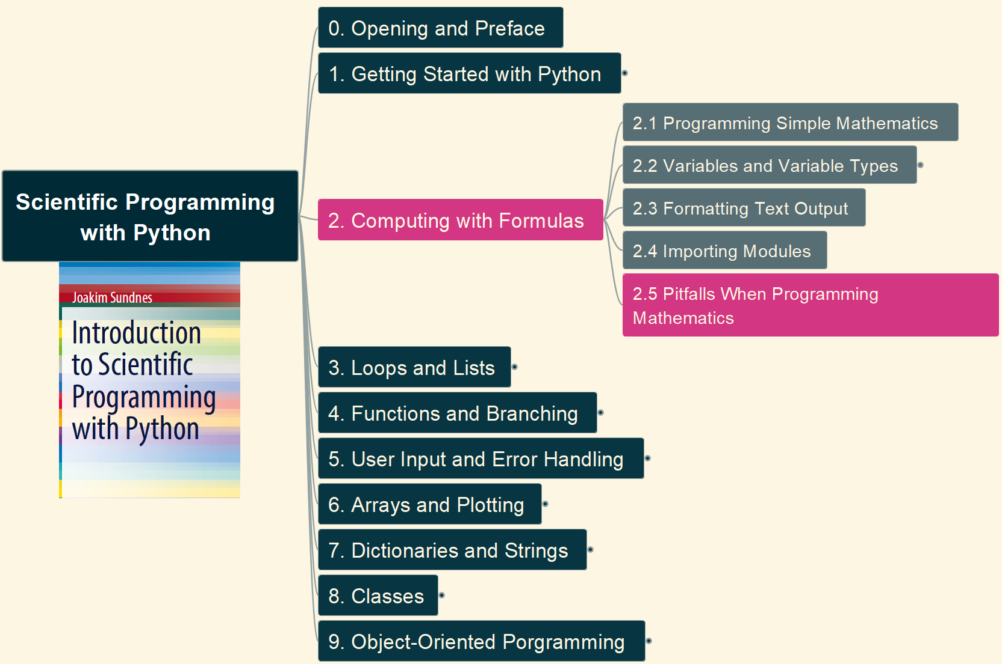

2. Computing with Formulas 2.5 Pitfalls When Programming Mathematics
009

Slide 10
